Slide 1

The ABP Framework
Halil İbrahim Kalkan & Alper Ebiçoğlu

Slide 2

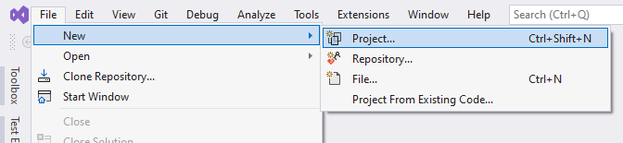

File -> New -> Project
Create a layered solution structure with the best practices
Install and configure all your favorite libraries and tools. Search for the others…
Setup your automated tests with mocking database and other infrastructure.
Create modern, responsive UI layouts with navigation, header, footer, toolbars… or apply a pre-built UI theme.
Train your developers how to use all these, or document..!
You already spent your weeks before writing a single line of your business code!

Slide 3
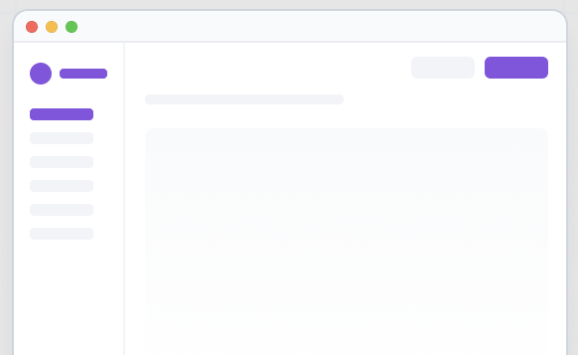



A Solution Template
The startup solution template
create new solution
a command-line utility
create new solution

Slide 4
Solution Template: Pains
Keep the solution template up-to-date!
Transfer fixes and improvements from solutions to the template.

Slide 5
Topic title
Content

Slide 6
Topic title
Content

Slide 7
Topic title
Content

Slide 8
Topic title
Content

Slide 9
Topic title
Content

